Slide 1
CST8219 C++ Programming
Installing Windows Subsystem for Linux

Slide 2
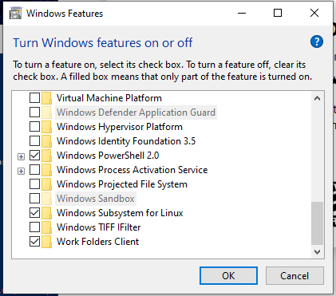
Introduction
You can now run linux natively on your Windows computer. You must first enable Windows Subsystem for Linux.
Type Windows + S to search for programs. In the search field, type “Turn Windows features on or off” and select the program.
Select “Windows Subsystem for Linux” and
click Ok.

Slide 3
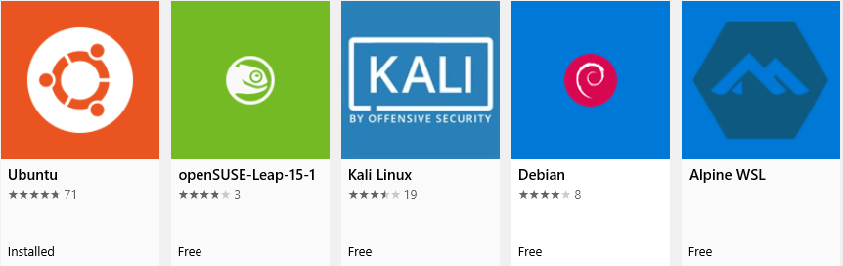
Introduction
Open the Microsoft Store and search for “Linux”. You have several distributions to choose from:
Choose one and select “Install”

Slide 4
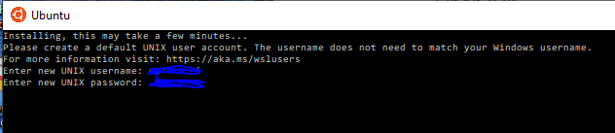
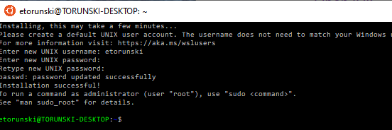
Create Unix account
Create a new account for your linux machine:
And done:

Slide 5
Windows C:\ drive
Your Windows drives are all accessible from Linux. Just go to:
cd /mnt
Your C:\ drive in Windows will be in /mnt/c
Your D:\ drive in Windows will be in /mnt/d
To install software in linux, use apt:
sudo apt install git
sudo apt install gcc
It’s also a good idea to update the apt repositories first by typing:
sudo apt-get update
sudo apt-get upgrade

